Slide 1
CS703 - Advanced Operating Systems
By Mr. Farhan Zaidi

Slide 2
Lecture No. 24

Slide 3
Overview of today’s lectures
Paging
Address translation
Page tables and Page table entries
Multi-level address translation
Page faults and their handling

Slide 4
Modern technique: Paging
Solve the external fragmentation problem by using fixed sized units in both physical and virtual memory
virtual address space
physical address space
page 0
frame 0
page 1
frame 1
page 2
frame 2
page 3
…
…
frame Y
page X

Slide 5
User’s perspective
Processes view memory as a contiguous address space from bytes 0 through N
  virtual address space (VAS)
In reality, virtual pages are scattered across physical memory frames – not contiguous as earlier
  virtual-to-physical mapping
  this mapping is invisible to the program
Protection is provided because a program cannot reference memory outside of its VAS
  the virtual address 0x356AF maps to different physical addresses for different processes
Note: Assume for now that all pages of the address space are resident in memory – no “page faults”

Slide 6
Address translation
Translating virtual addresses
  a virtual address has two parts: virtual page number & offset
  virtual page number (VPN) is index into a page table
  page table entry contains page frame number (PFN)
  physical address is PFN::offset
Page tables
  managed by the OS
  map virtual page number (VPN) to page frame number (PFN)
    VPN is simply an index into the page table
  one page table entry (PTE) per page in virtual address space
    i.e., one PTE per VPN

Slide 7
A System with paging based hardware support
Examples:
  workstations, servers, modern PCs, etc.
Memory
0:
Page Table
1:
Virtual
Addresses
Physical
Addresses
0:
1:
CPU
P-1:
N-1:
Disk
Address Translation: Hardware converts virtual addresses to physical addresses via OS-managed lookup table (page table)

Slide 8
Mechanics of address translation
virtual address
virtual page #
offset
physical memory
page
frame 0
page table
page
frame 1
physical address
page
frame 2
page frame #
page frame #
offset
page
frame 3
…
page
frame Y

Slide 9
Example of address translation
Assume 32 bit addresses
  assume page size is 4KB (4096 bytes, or 2¹² bytes)
  VPN is 20 bits long (2²⁰ VPNs), offset is 12 bits long
Let’s translate virtual address 0x13325328
  VPN is 0x13325, and offset is 0x328
  assume page table entry 0x13325 contains value 0x03004
    page frame number is 0x03004
    VPN 0x13325 maps to PFN 0x03004
  physical address = PFN::offset = 0x03004328

Slide 10
Page Table Entries (PTEs)
1
1
1
2
20
V
R
M
prot
page frame number
PTE’s control mapping
  the valid bit says whether or not the PTE can be used
    says whether or not a virtual address is valid
    it is checked each time a virtual address is used
  the referenced bit says whether the page has been accessed
    it is set when a page has been read or written to
  the modified bit says whether or not the page is dirty
    it is set when a write to the page has occurred
  the protection bits control which operations are allowed
    read, write, execute
  the page frame number determines the physical page
    physical page start address = PFN

Slide 11
Paging advantages
Easy to allocate physical memory
  physical memory is allocated from free list of frames
    to allocate a frame, just remove it from the free list
  external fragmentation is not a problem!
    managing variable-sized allocations is a huge pain
Leads naturally to virtual memory
  entire program need not be memory resident
  take page faults using “valid” bit
  but paging was originally introduced to deal with external fragmentation, not to allow programs to be partially resident

Slide 12
Paging disadvantages
Can still have internal fragmentation
  process may not use memory in exact multiples of pages
Memory reference overhead
  2 references per address lookup (page table, then memory)
  solution: use a hardware cache to absorb page table lookups
    translation lookaside buffer (TLB) –
    Memory required to hold page tables can be large
  need one PTE per page in virtual address space
  32 bit AS with 4KB pages = 2²⁰ PTEs = 1,048,576 PTEs
  4 bytes/PTE = 4MB per page table
    OS’s typically have separate page tables per process
    25 processes = 100MB of page tables
  solution: page the page tables (!!!)

Slide 13
Page Faults (like “Cache Misses”)
What if an object is on disk rather than in memory?
  Page table entry indicates virtual address not in memory
  OS exception handler invoked to move data from disk into memory
    current process suspends, others can resume
    OS has full control over placement, etc.
Before fault
After fault
Memory
Memory
Page Table
Virtual
Addresses
Physical
Addresses
Page Table
Virtual
Addresses
Physical
Addresses
CPU
CPU
Disk
Disk

Slide 14
Servicing a Page Fault
(1) Initiate Block Read
Processor Signals Controller
  Read block of length P starting at disk address X and store starting at memory address Y
Read Occurs
  Direct Memory Access (DMA)
  Under control of I/O controller
I / O Controller Signals Completion
  Interrupt processor
  OS resumes suspended process
Processor
Reg
(3) Read Done
Cache
Memory-I/O bus
(2) DMA Transfer
I/O
controller
Memory
disk
disk
Disk
Disk

Slide 15
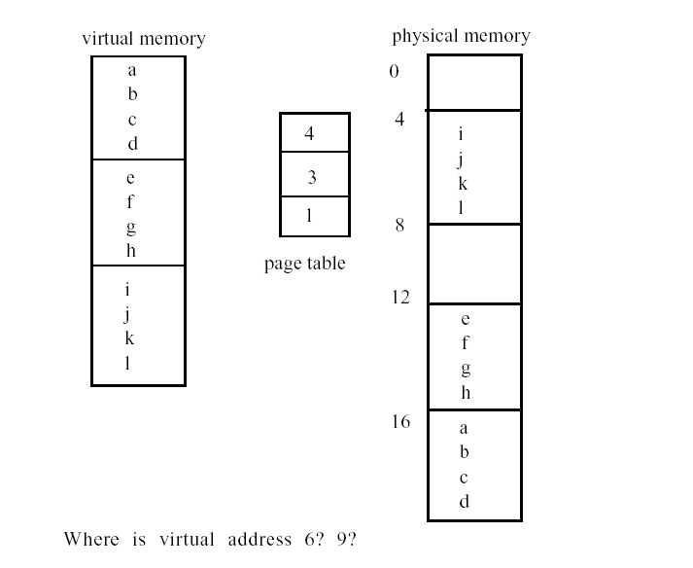
Example: suppose page size is 4 bytes.

Slide 16
Fragmentation: wasted space
What if page size is very small? For example, VAX had a
page size of 512 bytes. Means lots of space taken up with page
table entries.
What if page size is really big? Why not have an infinite
page size? Would waste unused space inside of page. Example
of internal fragmentation.
external -- free gaps between allocated chunks
internal -- free gaps because don't need all of allocated chunk
With segmentation need to re-shuffle segments to avoid
external fragmentation. Paging suffers from internal
fragmentation.

Slide 17
Multi-Level Page Tables
Level 2
Tables
Given:
  4KB (2¹²) page size
  32-bit address space
  4-byte PTE
Problem:
  Would need a 4 MB page table!
    2²⁰ *4 bytes
Common solution
  multi-level page tables
  e.g., 2-level table (P6)
    Level 1 table: 1024 entries, each of which points to a Level 2 page table.
    Level 2 table: 1024 entries, each of which points to a page
Level 1
Table
...

Slide 18
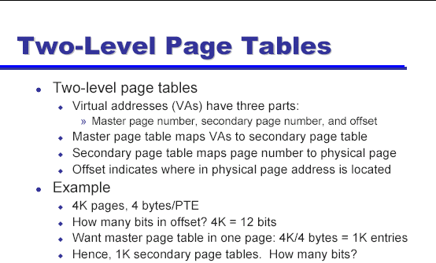

Slide 19
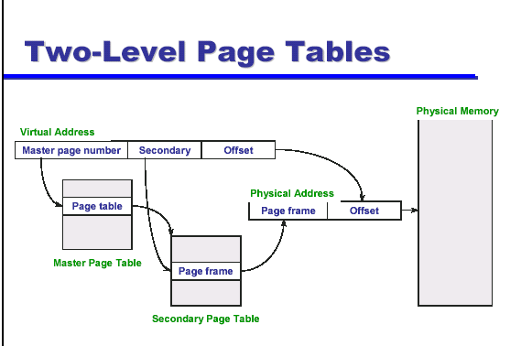

Slide 20
